Slide 1

Innovative Projects in AI
Master 1 SDIA
Pr. A LAYEB

Slide 2

Introduction to Innovative AI Projects:
Artificial Intelligence (AI) has become a transformative force across various industries, driving innovation, efficiency, and new possibilities.
Innovative AI projects span a wide range of applications, from healthcare and finance to education and entertainment.
The ideation, development, and deployment of these projects involve a multidisciplinary approach, combining expertise in data science, machine learning, and domain-specific knowledge.

Slide 3
Main components of Innovative projects in AI
The ideation,
Development,
Deployment

Slide 4
Ideation:
Ideation in AI projects refers to the creative process of generating and developing innovative ideas for solving problems, creating new features, or enhancing existing systems using artificial intelligence. It's a crucial phase that involves brainstorming, conceptualization, and exploration of diverse possibilities. Here are some key aspects and methods related to ideation in AI projects:
Identifying Challenges:
AI projects often begin by identifying challenges or inefficiencies in existing processes.
Teams explore how AI can address these challenges, enhance decision-making, or automate tasks.
Market Research:
Understanding market needs and trends is crucial for AI project success.
Identifying gaps in existing solutions or anticipating future demands informs the project's direction.
Data Exploration:
Examining available datasets helps in determining the feasibility of an AI project.
Clean, relevant, and diverse data is essential for training robust machine learning models.

Slide 5
Development:
Algorithm Selection:
Choosing the right algorithms depends on the nature of the problem.
Deep learning, reinforcement learning, and classical machine learning are common approaches.
Model Training:
Training models involves feeding them with labeled data to learn patterns and make predictions.
Continuous refinement and optimization of models contribute to their accuracy and reliability.
Interdisciplinary Collaboration:
Collaboration between data scientists, domain experts, and software engineers is vital.
The synergy of diverse skills ensures a comprehensive solution that aligns with real-world needs.

Slide 6
Deployment:
Integration with Existing Systems:
Integrating AI solutions into existing systems requires careful planning to minimize disruptions.
Compatibility with legacy infrastructure is often a crucial consideration.
User Interface and Experience:
Developing intuitive interfaces ensures user adoption and acceptance.
Transparency in AI decision-making fosters trust among end-users.
Monitoring and Iteration:
Continuous monitoring post-deployment helps identify issues and improve performance.
Iterative updates based on real-world feedback enhance the system over time.

Slide 7
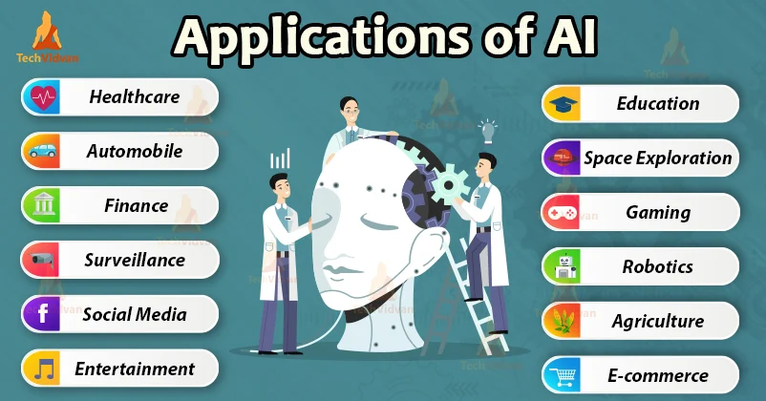

Slide 8
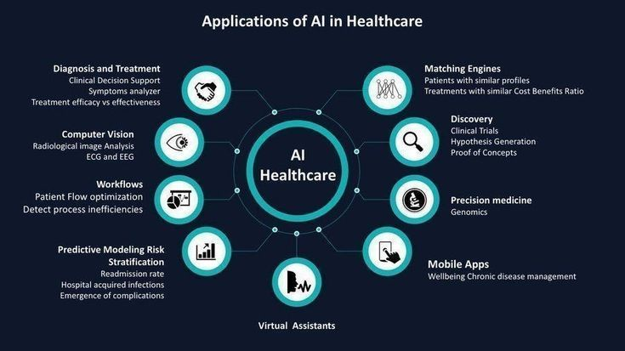
Case Studies:Healthcare:
Artificial Intelligence in healthcare has a wide scope. Scientists are creating new ways to use it properly every day. AI in healthcare can take care of wellness, diagnostics, and even operational technologies.

Slide 9
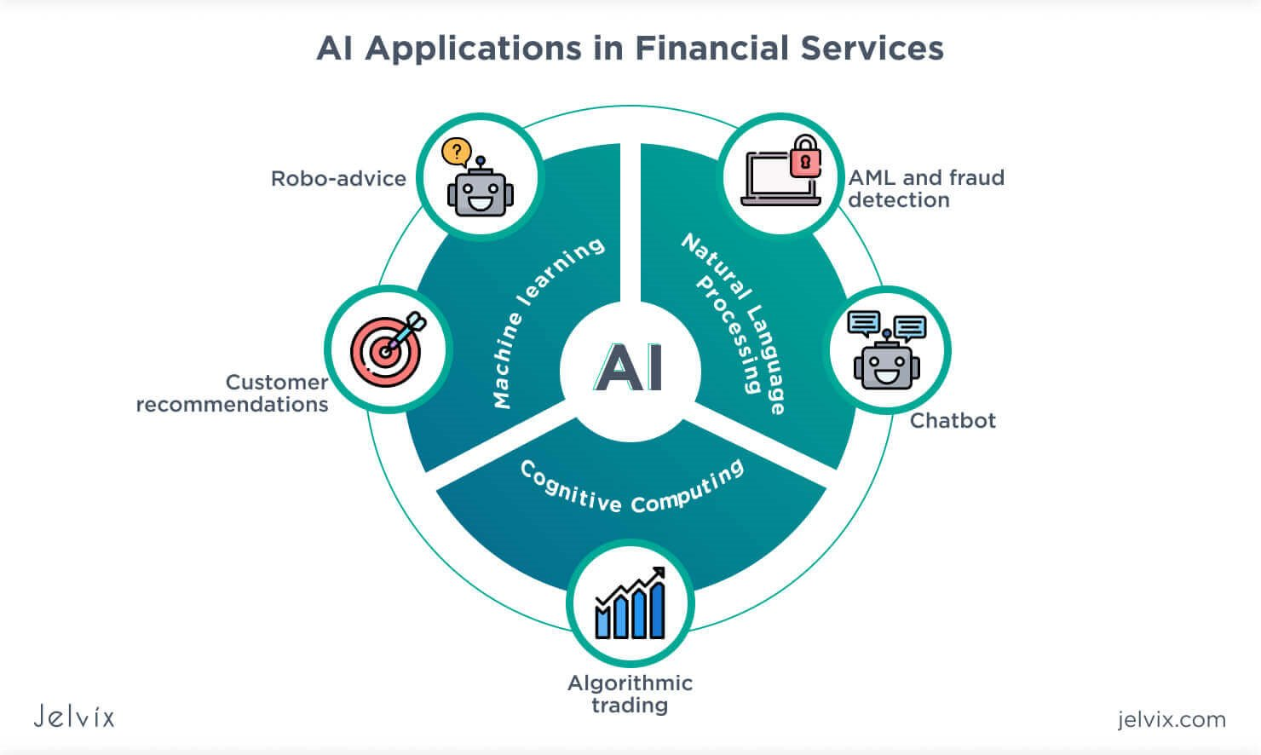
Case Studies: Finance:
Artificial intelligence (AI) in finance helps drive insights for:
data analytics,
performance measurement, predictions and forecasting,
real-time calculations,
customer servicing,
intelligent data retrieval,
And more.

Slide 10
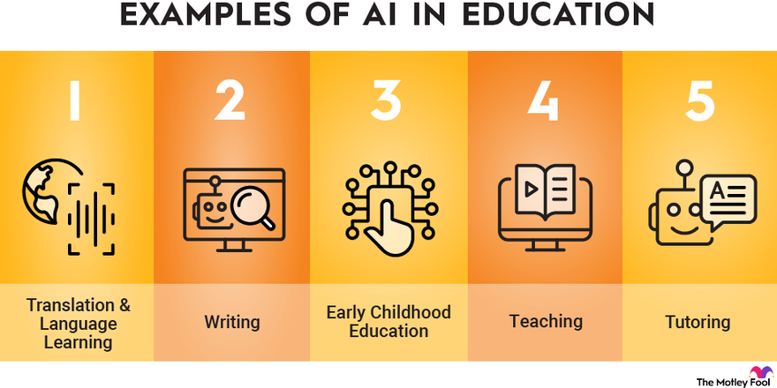
Case Studies: Education
AI is growing rapidly in the education sector, and it is becoming a multi-billion dollar global market. This rapid growth is due to its ability to transform many aspects of the teaching and learning processes. AI can create immersive virtual learning environments, produce “smart content,” ease language barriers, fill gaps between learning and teaching, create specialized plans for each student, and much more.

Slide 11

Case Studies: autonomuous vehicle
A self-driving car (sometimes called an autonomous car or driverless car) is a vehicle that uses a combination of sensors, cameras, radar and artificial intelligence (AI) to travel between destinations without a human operator

Slide 12

Case Studies: AI and Drones
Drones have become a popular and important technology in recent years, used in everything from aerial photography to military operations.
With advancements in artificial intelligence (AI), drones are now able to do much more than just fly and capture images.
AI technology has revolutionized the capabilities of drones, making them more intelligent, efficient, and autonomous than ever before.

Slide 13
Designing innovative AI projects
Designing innovative AI projects involves a combination of strategic planning, technical expertise, and creativity. Here are some methods and approaches that are commonly used:
Identify a Problem or Opportunity:
Start by identifying a real-world problem or opportunity that can benefit from AI solutions. Understand the domain and stakeholders involved.
Define Clear Objectives:
Clearly define the objectives of your AI project. What are you trying to achieve? Define measurable goals that align with the problem or opportunity you identified.
Data Collection and Preparation:
Gather relevant data for training and testing your AI model. Ensure the data is representative, clean, and appropriately labeled. Data preparation is a crucial step to ensure the quality and effectiveness of your AI system.

Slide 14
Designing innovative AI projects
4. Choose the Right Algorithms:
Select the appropriate machine learning or deep learning algorithms based on the nature of your problem. Consider factors such as data complexity, size, and available resources.
5. Experimentation and Prototyping:
Experiment with different models and techniques. Build prototypes to test the feasibility of your approach. This iterative process helps in refining your ideas and selecting the most effective solution.
Interdisciplinary Collaboration:
Foster collaboration between experts from different domains. AI projects often require expertise in both the technical and application domains. Engage with domain experts to ensure a comprehensive understanding of the problem.

Slide 15
Designing innovative AI projects
Ethical Considerations:
Consider the ethical implications of your AI project. Ensure that your design and implementation adhere to ethical guidelines, privacy standards, and legal requirements.
User-Centric Design:
Keep the end-users in mind during the design process. Understand their needs, preferences, and pain points. Design AI solutions that are user-friendly and provide tangible benefits.
Continuous Learning and Adaptation:
AI models should be capable of learning and adapting over time. Implement mechanisms for continuous learning and model updates to improve performance as more data becomes available.

Slide 16
Designing innovative AI projects
10. Iterative Development:
Adopt an iterative development process. Test and refine your AI system through multiple iterations. Collect feedback from users and stakeholders to make necessary adjustments.
11. Scalability and Deployment:
Design your AI solution with scalability in mind. Consider how it will handle increasing amounts of data and users. Plan for efficient deployment and integration into existing systems.
12. Monitoring and Maintenance:
Implement monitoring tools to keep track of your AI system's performance in real-world scenarios. Regularly update and maintain the system to ensure it continues to meet its objectives.
13. Feedback Loops:
Establish feedback loops to continuously gather insights from users, monitor performance, and incorporate improvements. This iterative feedback process helps in refining the AI project over time.

Slide 17
Design processes methods
Design Thinking:
Design Thinking is a human-centered approach that emphasizes empathy, ideation, and prototyping. It typically involves stages such as empathizing, defining, ideating, prototyping, and testing. This iterative process helps designers understand user needs and iterate on solutions.
User-Centered Design (UCD): (User experience design) (UX)
Focuses on involving end-users in the design process. It includes activities such as user research, persona creation, and usability testing. UCD ensures that the final product is intuitive and meets the needs of the intended users.
Agile Methodology:
Agile is an iterative and incremental approach to software development. It involves breaking down the development process into small, manageable increments or sprints. This method allows for flexibility, quick adaptation to changes, and continuous delivery of functional components.

Slide 18
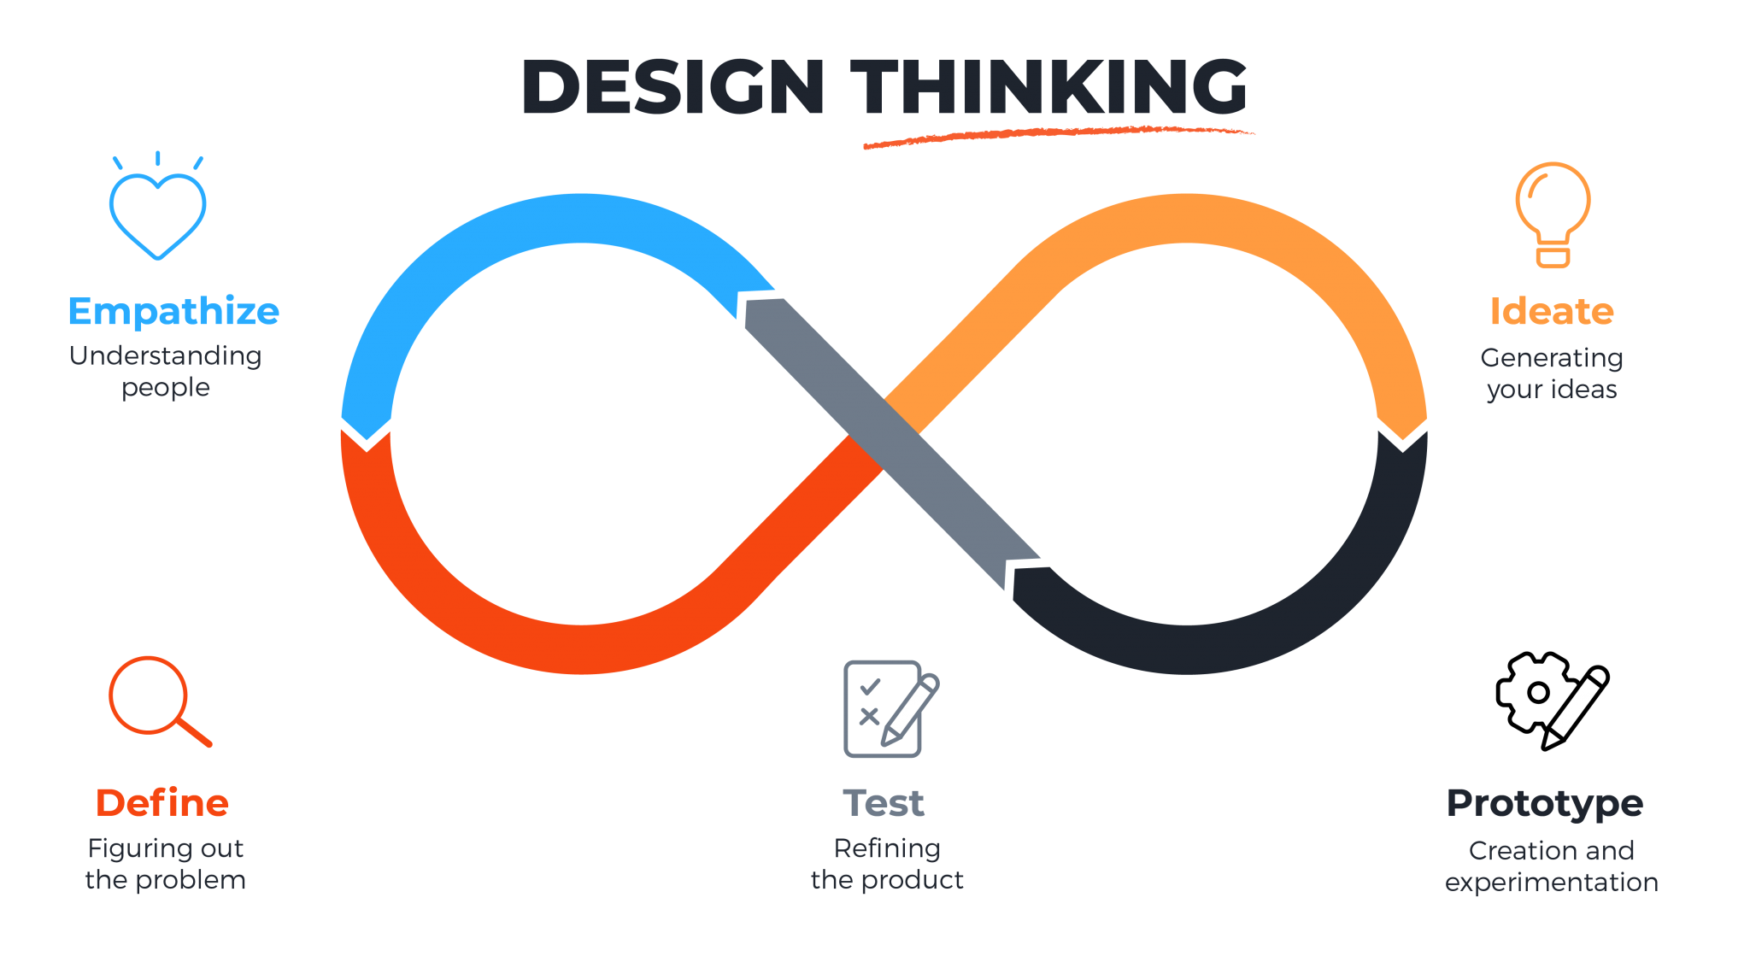
Design Thinking:
Empathize: Develop an understanding of the challenges the system/users are facing through observation (ie. interviews, surveys, etc.).
Define: Analyze data and clearly articulate the problem you want to solve.
Ideate: generate a large quantity of diverse ideas that could serve as potential solutions to the problem.
Prototype: Build a simulation of your ideas as prototypes to test as possible solutions.
Test: Share and test the prototype with end-users for assessment then implement feedback into rapid iteration.

Slide 19
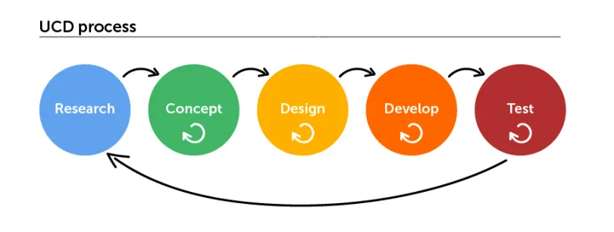
User-Centered Design (UCD):
User-centered design is an approach to design that focuses on users through planning, design and development of a product. Its processes and strategies vary depending on the type of design project, however, they are usually based on a combination of research and UX design activities.
This type of design process aims to actively involve users at every stage of the design process for the development of more effective, efficient and safe products. These stages includes:
Research & analysis
Concept & strategy
Design
Development
Implementation and testing
(User experience design) (UX)

Slide 20
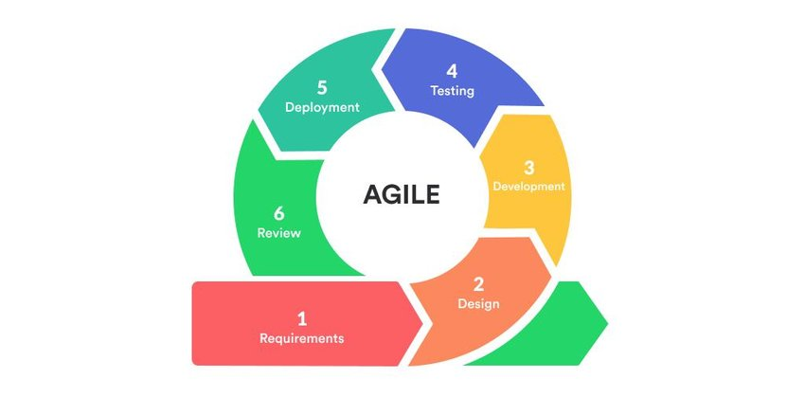
Agile Methodology:
Agile methodology is an iterative and incremental approach to software development and project management that prioritizes flexibility, collaboration, and customer satisfaction. It was developed as a response to traditional, linear project management methods that struggled to adapt to changing requirements and customer feedback.
Key Principles of Agile:
Individuals and Interactions over Processes and Tools:
Emphasizes the importance of effective communication and collaboration within the development team and with stakeholders.
Working Software over Comprehensive Documentation:
Prioritizes the delivery of functional software over extensive documentation. Documentation is still important, but it should not impede the progress of development.
Customer Collaboration over Contract Negotiation:
Encourages continuous collaboration with customers and stakeholders to understand and adapt to changing requirements, rather than relying on rigid contracts.
Responding to Change over Following a Plan:
Acknowledges the inevitability of change in software development. Agile teams are expected to respond to changing requirements and priorities throughout the project.

